Slide 1
SIGNAL ENCODING TECHNIQUES

Slide 2
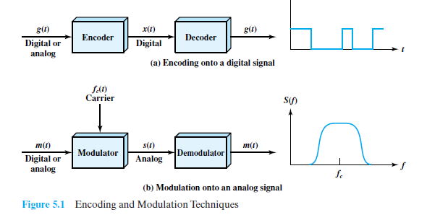
Encoding and Modulation Techniques
x(t) depends on the encoding technique and is chosen to optimize use of the transmission medium.

Slide 3
The basis for analog signaling is a continuous constant-frequency signal known as the carrier signal.
Data may be transmitted using a carrier signal by modulation.
Modulation is the process of encoding source data onto a carrier signal with frequency. All modulation techniques involve operation on one or more of the three fundamental frequency domain parameters: amplitude, frequency, and phase.
The input signal m(t) may be analog or digital and is called the modulating signal or baseband signal.
The result of modulating the carrier signal is called the modulated signal s(t).

Slide 4
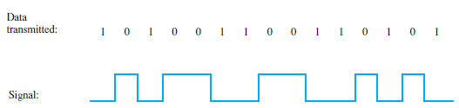
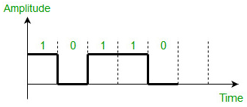
Digital data to digital signal
Key terms
Unipolar signaling schemes, sends only one polarity; when not sending, polarity is zero

Slide 5
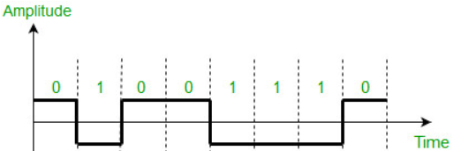
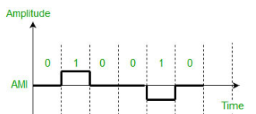

Polar signaling schemes, one logic state is represented by a positive voltage level, and the other by a negative voltage level
Bipolar signaling schemes– In this scheme there are three voltage levels positive, negative, and zero.

Slide 6
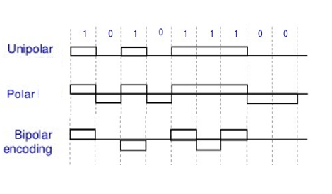
Unipolar, Polar and Bipolar schemes

Slide 7
At the transmitter:
The data signaling rate, or just data rate, of a signal is the rate, in bits per second, that data are transmitted.
The duration or length of a bit is the amount of time it takes for the transmitter to emit the bit; for a data rate R, the bit duration is 1/R.
The modulation rate(baud- signal elements per second), in contrast, is the rate at which the signal level is changed. This will depend on the nature of the digital encoding.

Slide 8
At the receiver:
It must know the timing of each bit. That is, the receiver must know with some accuracy when a bit begins and ends.
It must determine whether the signal level for each bit position is high (0) or low (1).

Slide 9
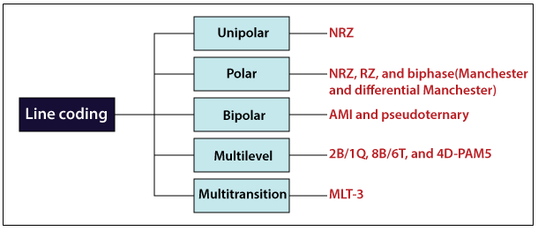

Slide 10
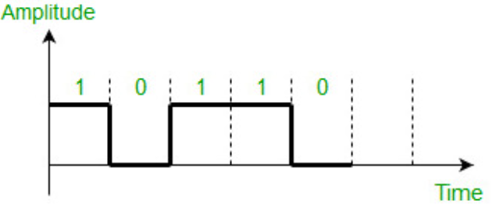
Non return to zero (NRZ)
NRZ - the signal does not return to zero at the middle of the bit. Positive voltage defines bit 1 and the zero voltage defines bit 0

Slide 11
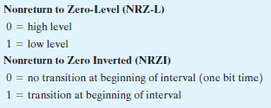
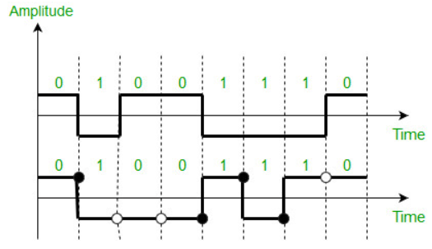

Slide 12
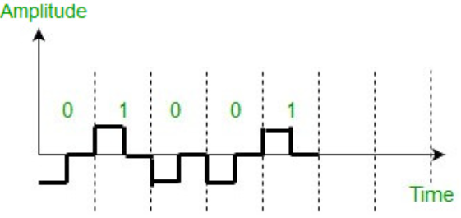
Return to zero (RZ)- uses three values positive, negative, and zero. In this scheme signal goes to 0 in the middle of each bit.

Slide 13
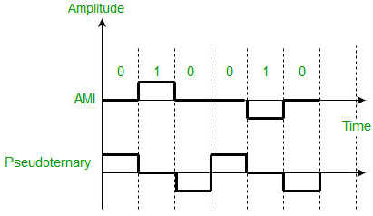
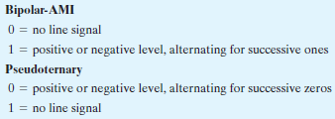
Alternate Mark Inversion (AMI) – A neutral zero voltage represents binary 0. Binary 1’s are represented by alternating positive and negative voltages.
Pseudoternary – Bit 1 is encoded as a zero voltage and the bit 0 is encoded as alternating positive and negative voltages i.e., opposite of AMI scheme. Example: Data=010010.

Slide 14
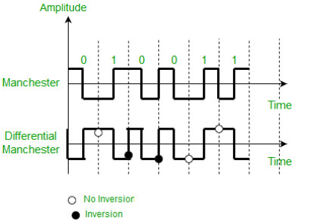
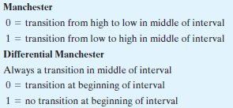

Slide 15
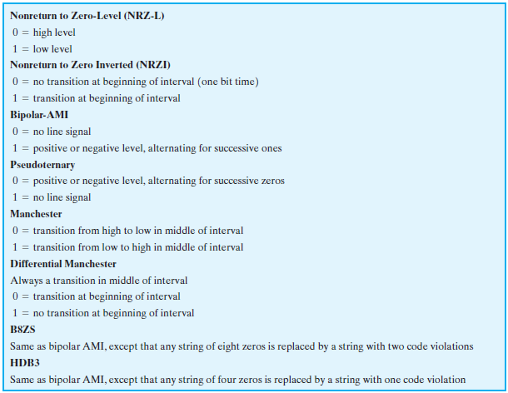
Digital data to digital signal

